Slide 1
SQL Server
Tools
In all slides, db=database

Slide 2
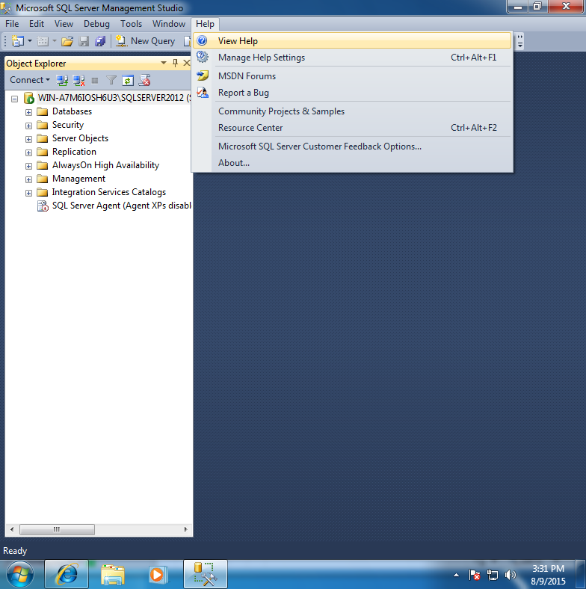
Books Online
You will never remember everything little thing you will ever need to know about SQL Server.
To access books online, click on help/contents.

Slide 3
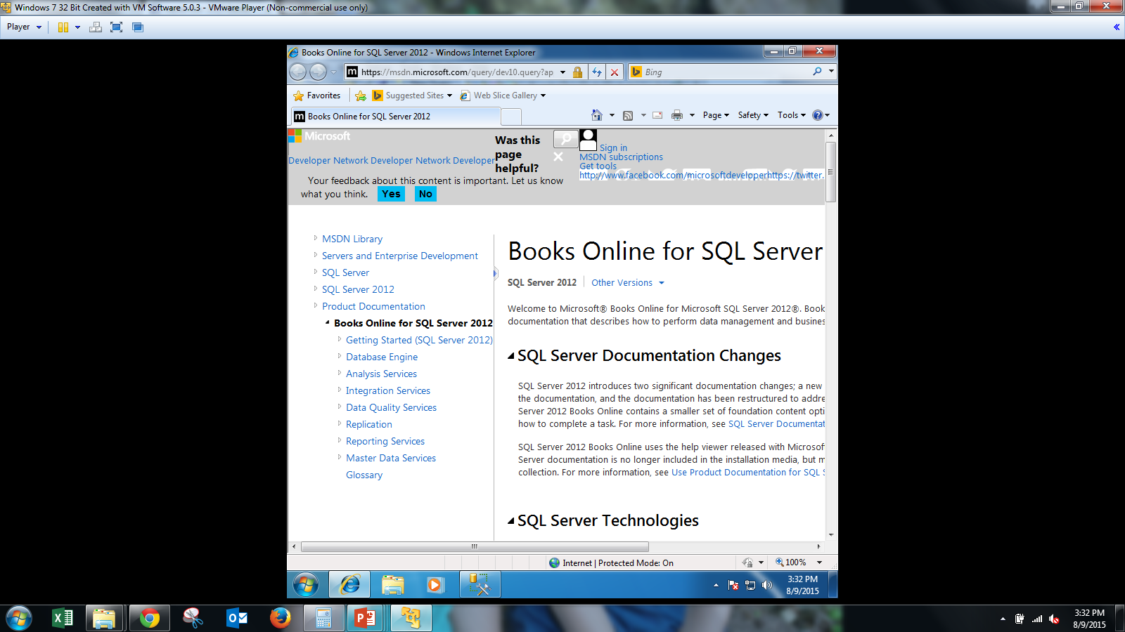
Books Online cont.
You will be presented with the help system for SQL Server 2012:

Slide 4
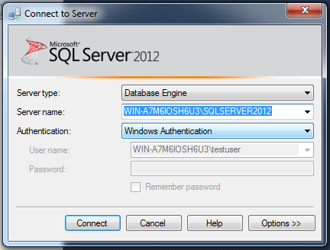
SQL Server Management Studio
When you first start the studio, you are presented with a connection dialog box:

Slide 5
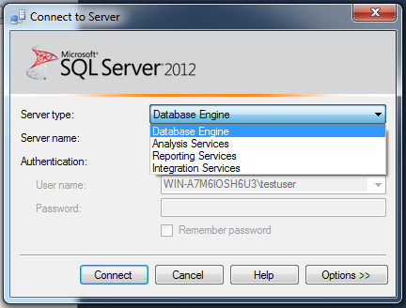
Server Type
When you first start the studio, you are presented with a connection dialog box:

Slide 6
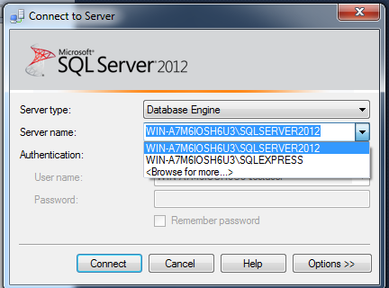
Server Name
This area indicates where you are logging in.
If you have more than one server, you can click the browse button and navigate to find the other
server names.

Slide 7
Authentication Type
There are two different modes of authentication:
  Windows – These users are validated through the Windows domain and mapped to roles according to Login.
  SQL Server – One user can have multiple logins that give different rights to different things.

Slide 8
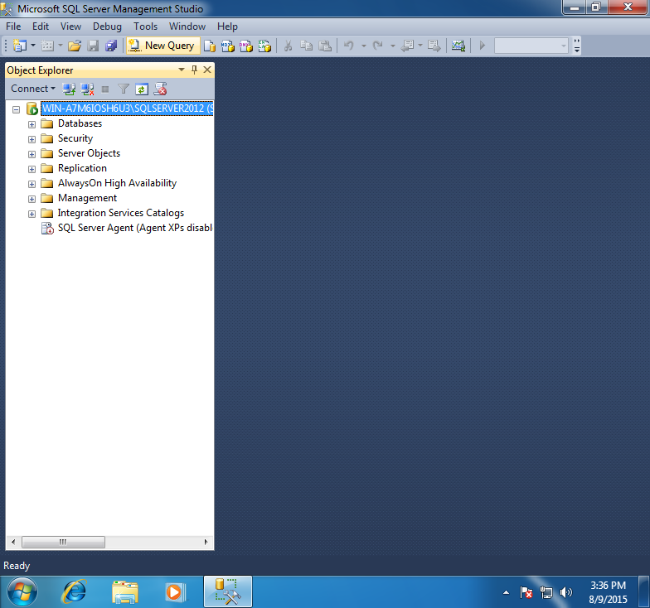
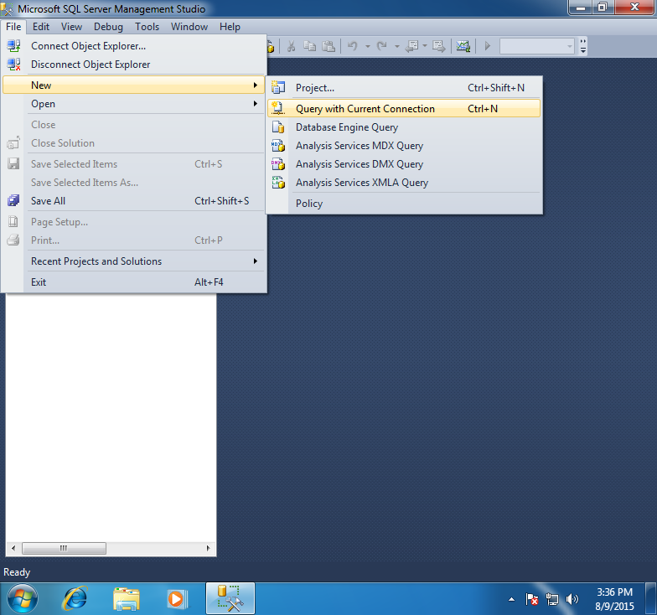
Query Window
The query window is where you can execute statements using Transact-SQL (T-SQL). T-SQL is the native language of SQL Server.
OR:
Notes:
You could add new user groups that would be cloned into every new database that was created on the system.

Slide 9
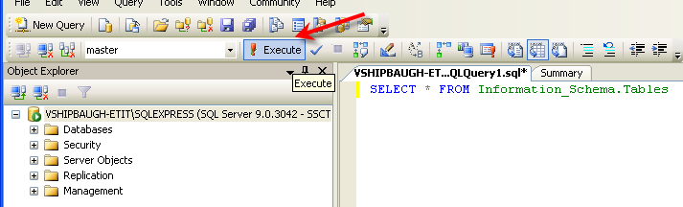
The Query Window cont.
Statement keywords should appear in blue; unidentifiable items are in black; statement arguments and connectors are in red.
To run the query, click the button with the red exclamation point:

Slide 10
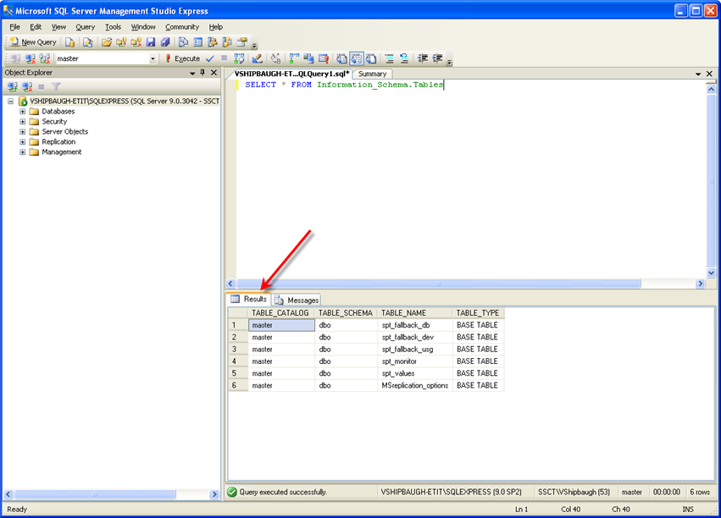
The Query Window cont.
The main window is divided into two panes:

Slide 11
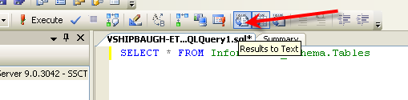
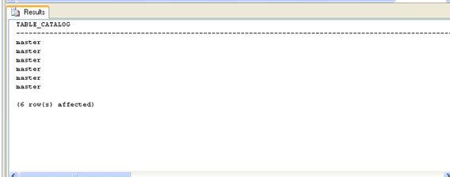
The Query Window cont.
The Results in Text option takes all the output from your query and puts it into one page of text results.

Slide 12
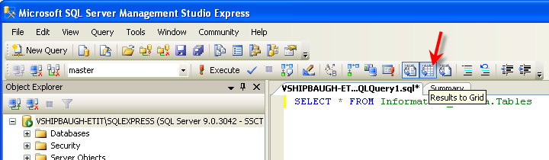
The Query Window cont.
The Results in Grid option divides the columns and rows into a grid arrangement.
You can resize the column, select several cells at a time, or select columns in multiple rows.

Slide 13
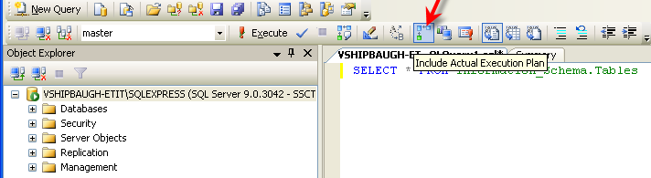
The Query Window cont.
Every time a query is run, SQL Server parses the query into its component parts and then sends it to the query optimizer.
The query optimizer is the part of SQL Server that figures out the best way to run a query to balance fast results with minimum impact to other users.

Slide 14
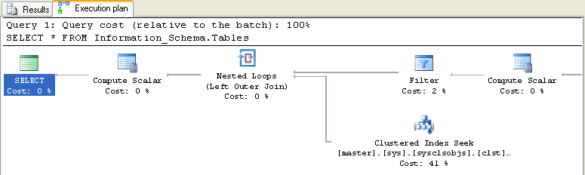
The Query Window cont.
The show execution plan will give you the results after the query is run, the show estimated execution plan gives you the “plan” before the query.

